Slide 1
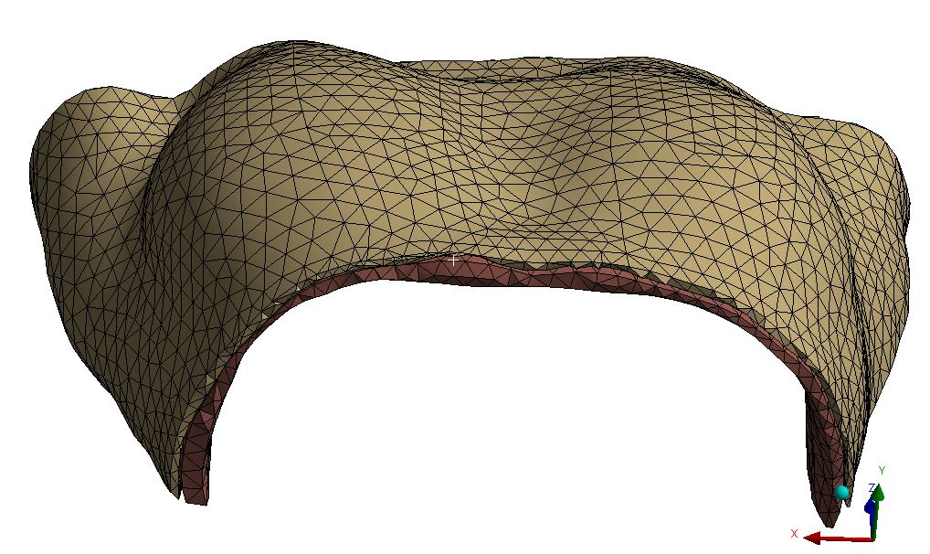
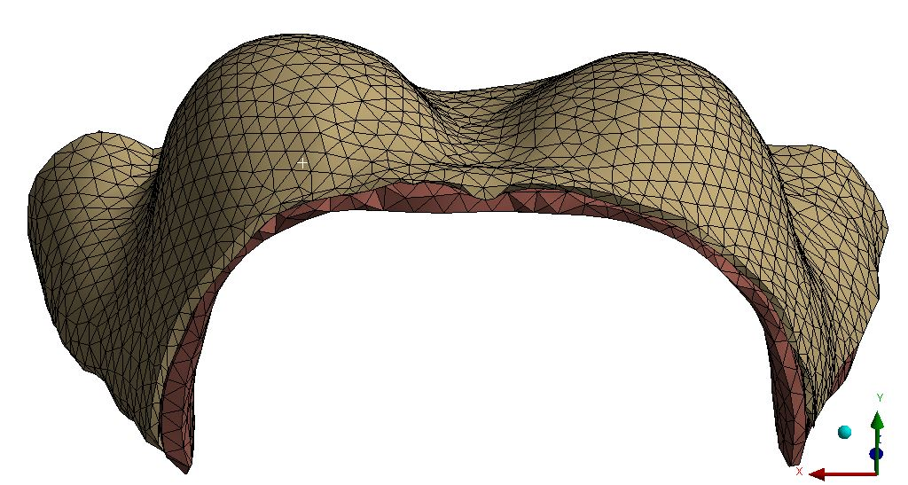
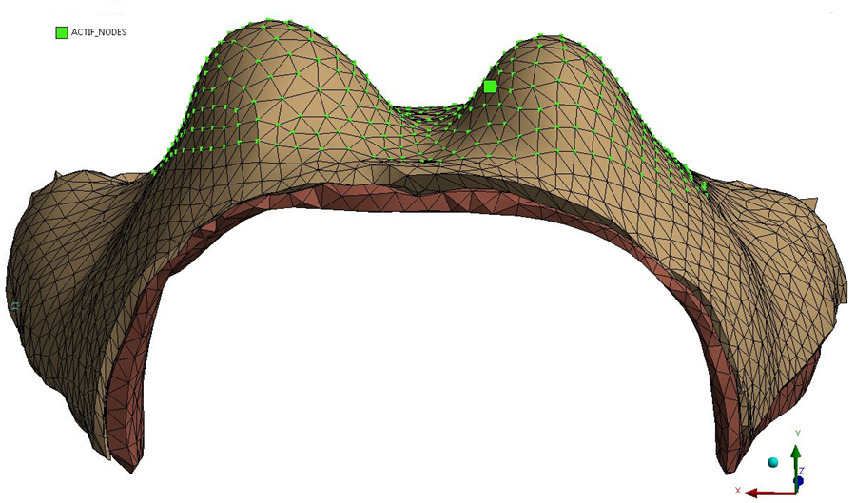
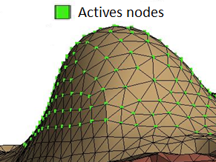
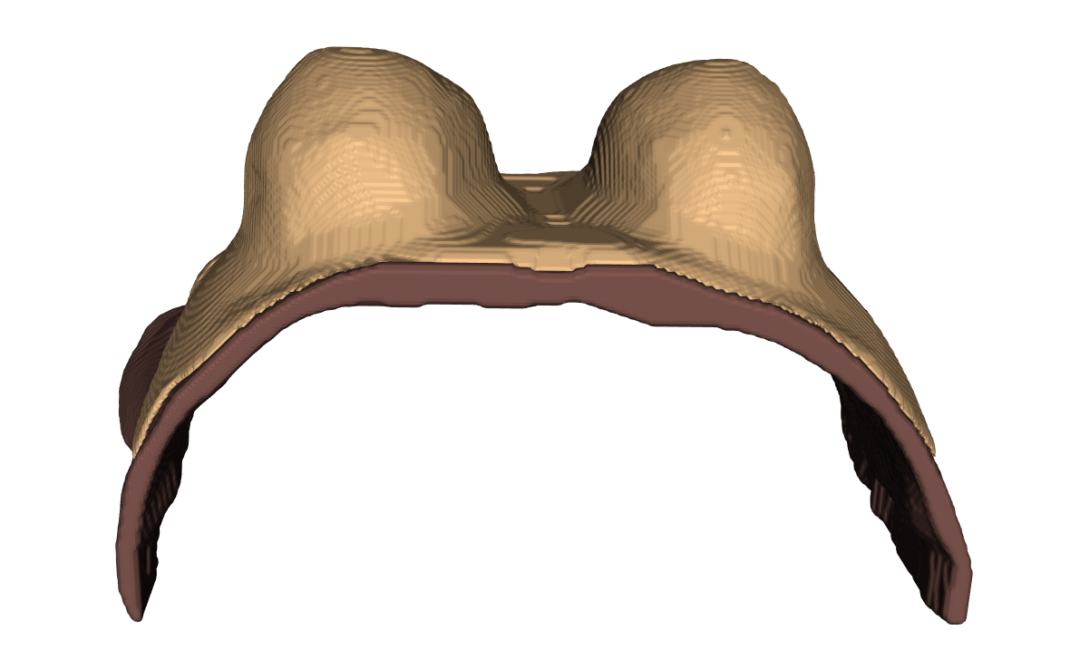
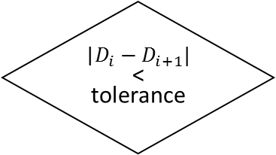
Measured supine configuration
Apply gravity towards anterior
Stress-free
configuration
Apply gravity towards anterior
Estimated prone
configuration
G
G
G
G
Apply position difference (α*∆) for active nodes in stress-free configuration (only surface nodes)
Optimized
stress-free configuration
No
Yes
|$D_{i}−D_{i+1}|$
< tolerance
Compute position difference (∆) for the actives nodes in prone configuration (only surface nodes)
Measured prone configuration
G

Slide 2
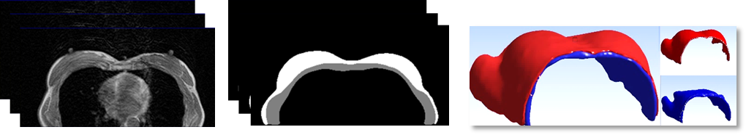
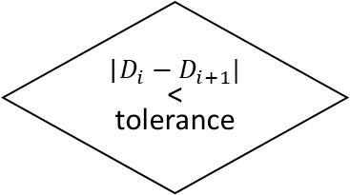
a)
b)
c)
Breast
Muscle
Measured prone configuration
Apply gravity towards anterior
Stress-free
configuration
Apply gravity towards anterior
Estimated prone
configuration
G
G
G
G
Update surface nodes
No
Optimized
stress-free configuration
Yes
|$D_{i}−D_{i+1}|$
< tolerance
Compute difference of the surface nodes position between estimated and measured geometries
Measured prone configuration
G

Slide 3
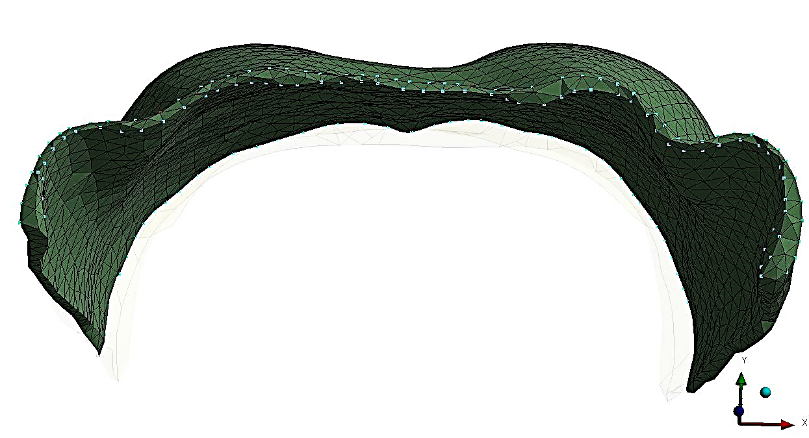
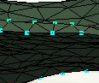

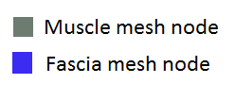
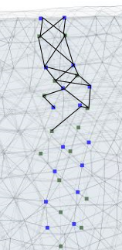
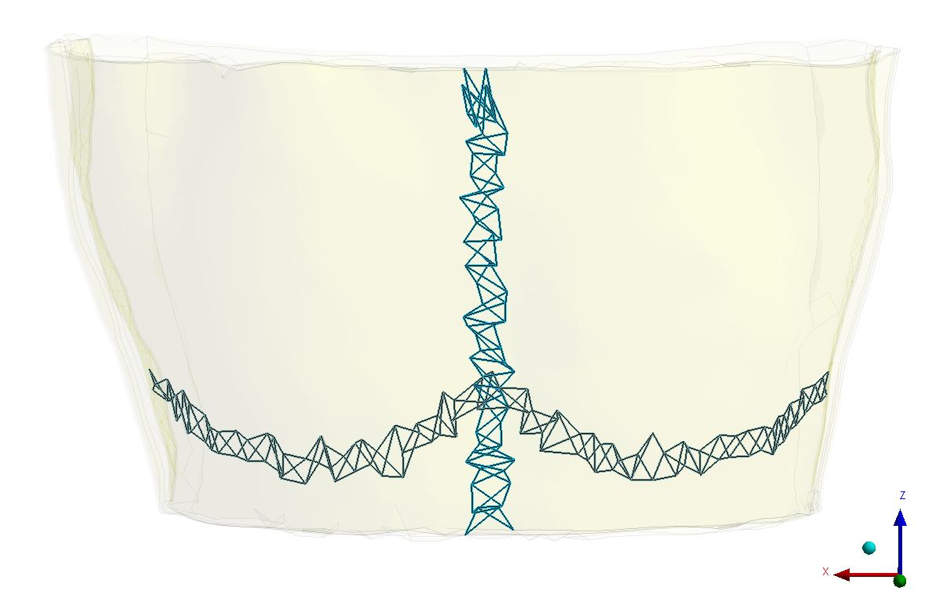
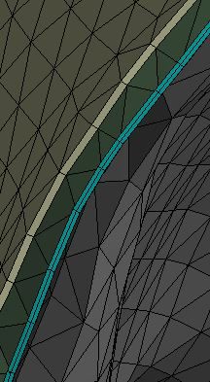
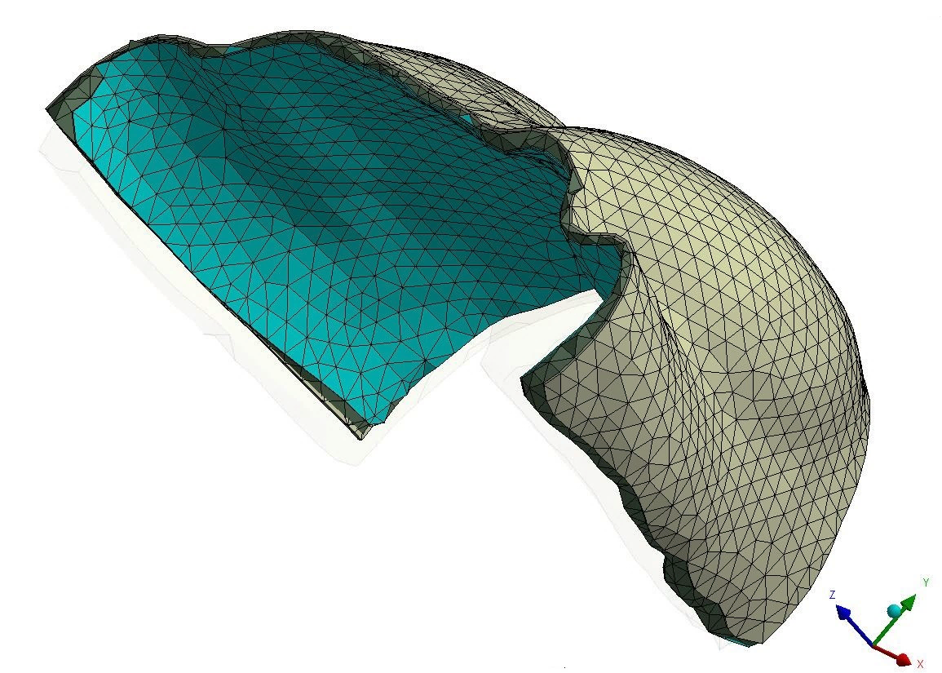
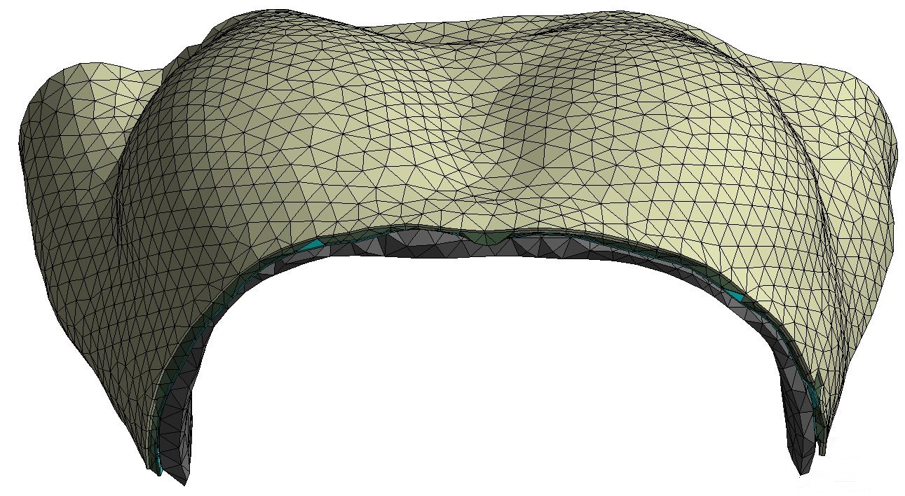
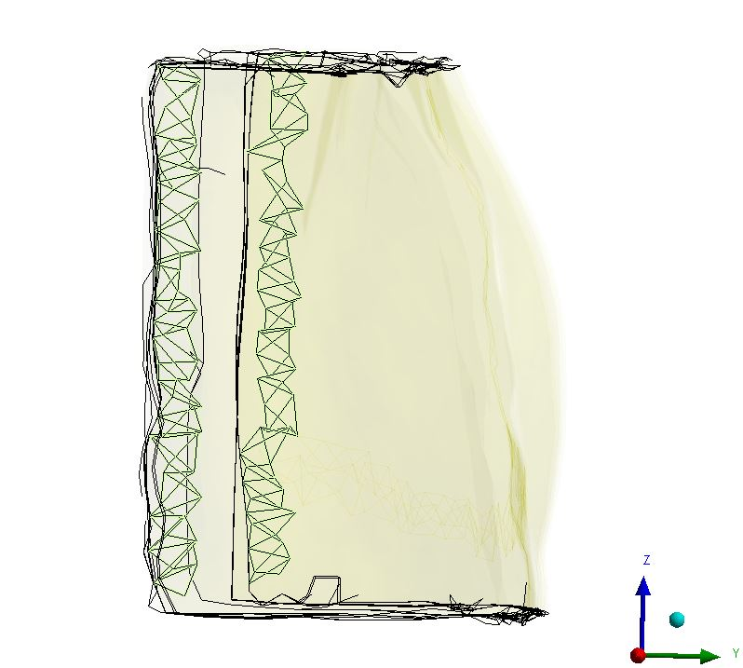
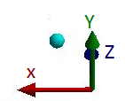
Fixed node on Y axis
Fixed node on Z axis
Muscle mesh node
Fascia mesh node
Muscle
2
3
Deep fascia
Breast tissue
4
Inframammary ligament
Skin + superficial fascia
1
Deep medial ligament
Boundary condition

Slide 4
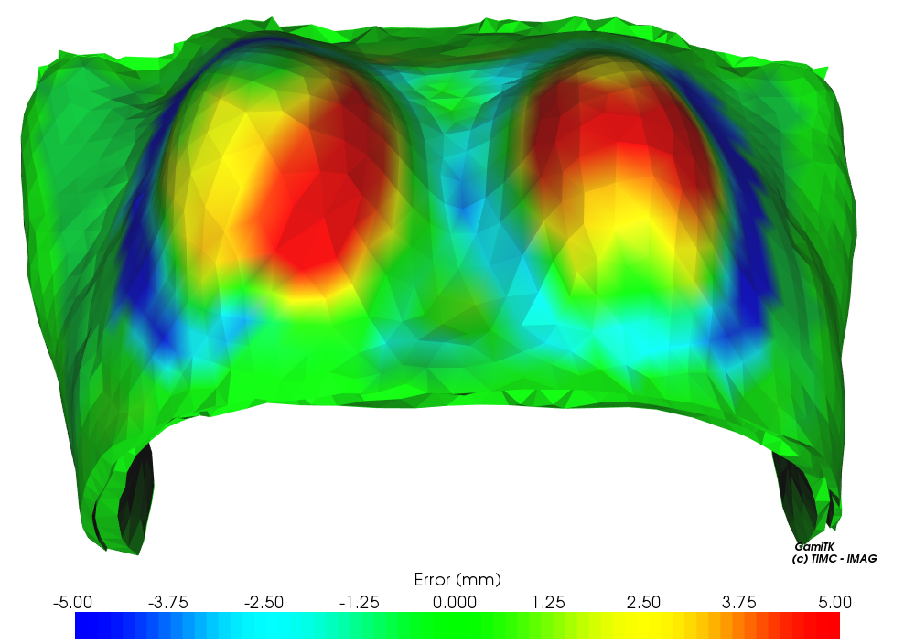
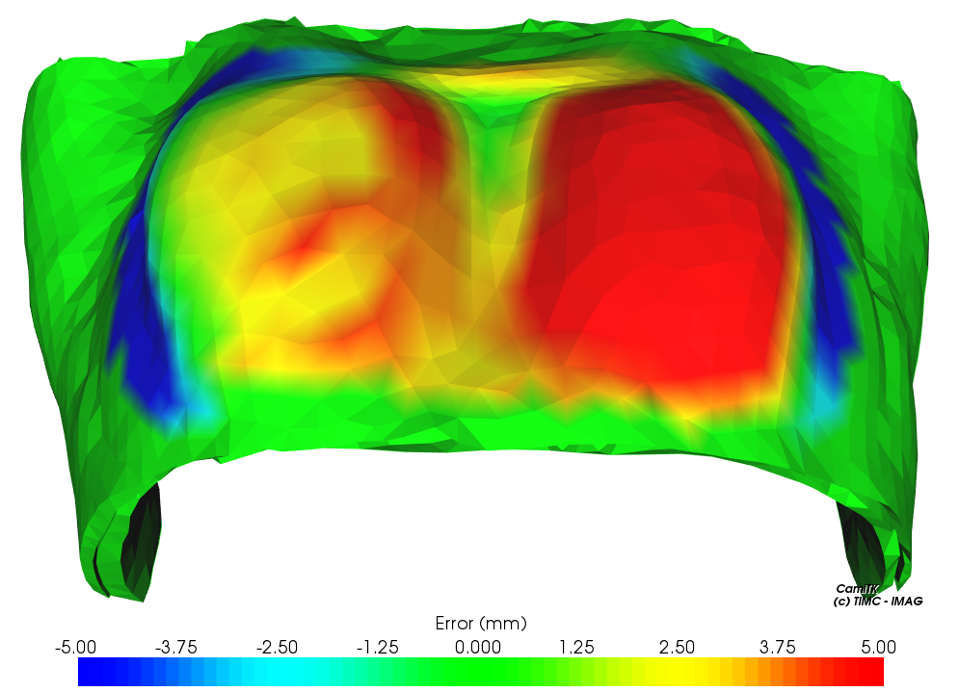
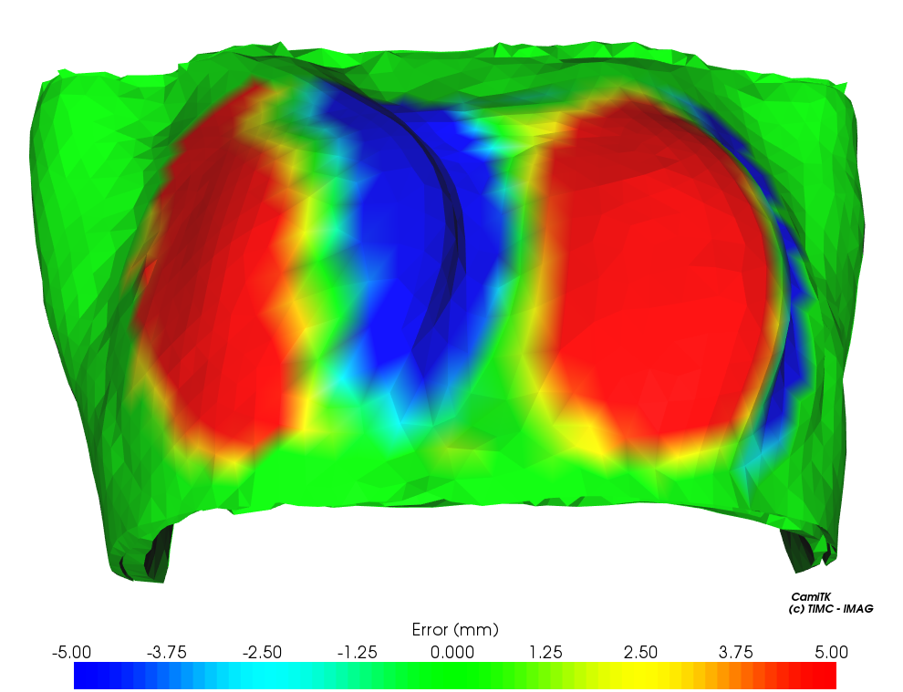
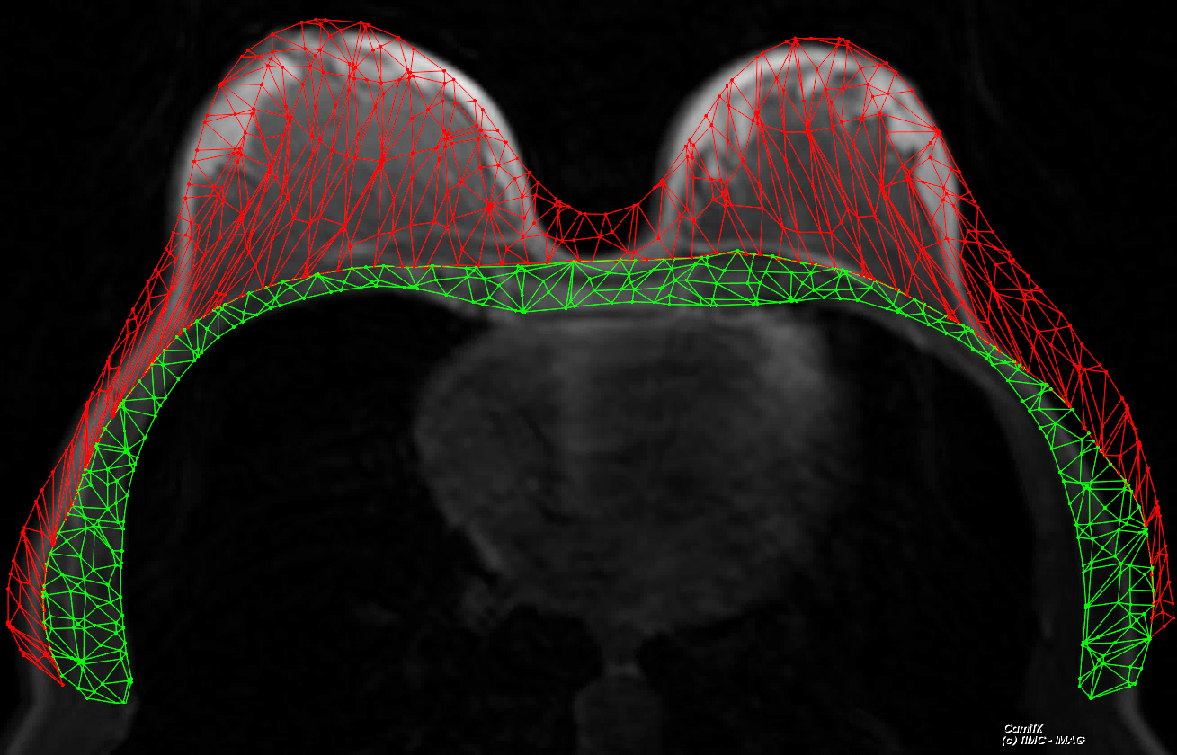
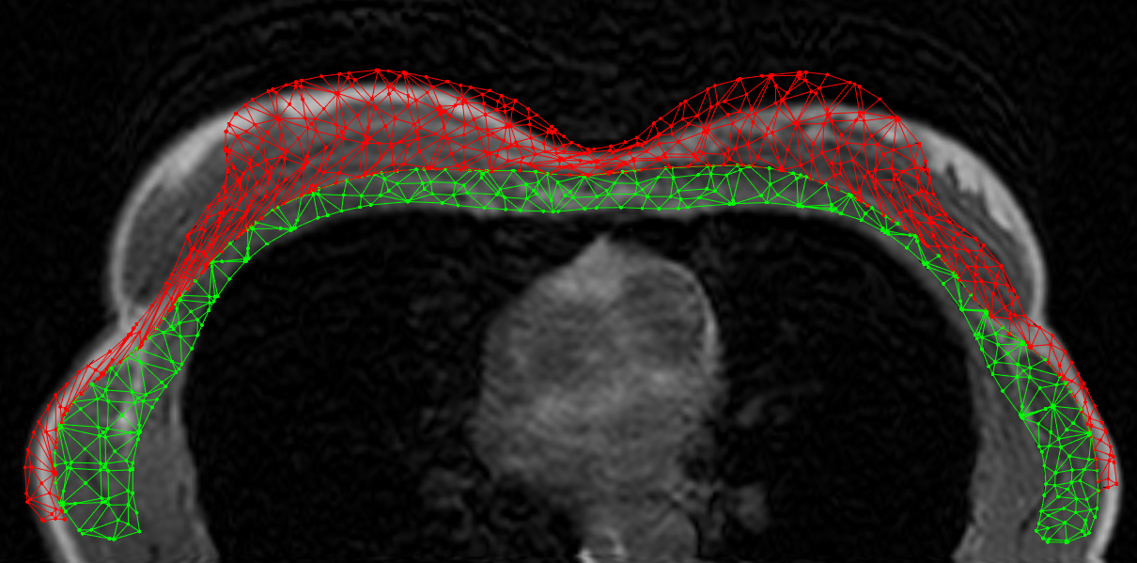
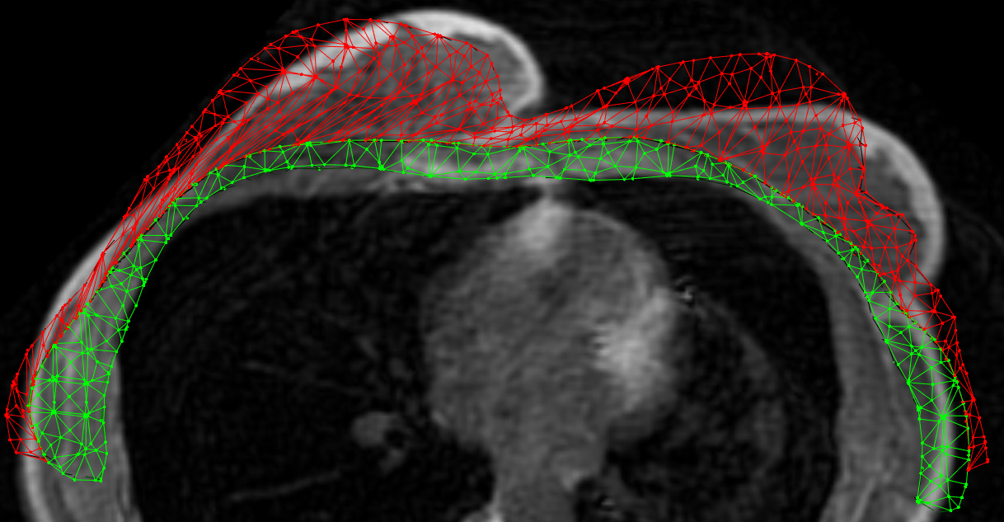
Min distance = -7.71
Max distance = 7.64
Mean distance = 2.48
Standard deviation = 1.74
Min distance = -13.46
Max distance = 10.20
Mean distance = 4.62
Standard deviation = 3.20
Min distance = -19.84
Max distance = 14.12
Mean distance = 6.64
Standard deviation = 4.53
a) Prone
b) Supine
c) Supine tilted

Slide 5
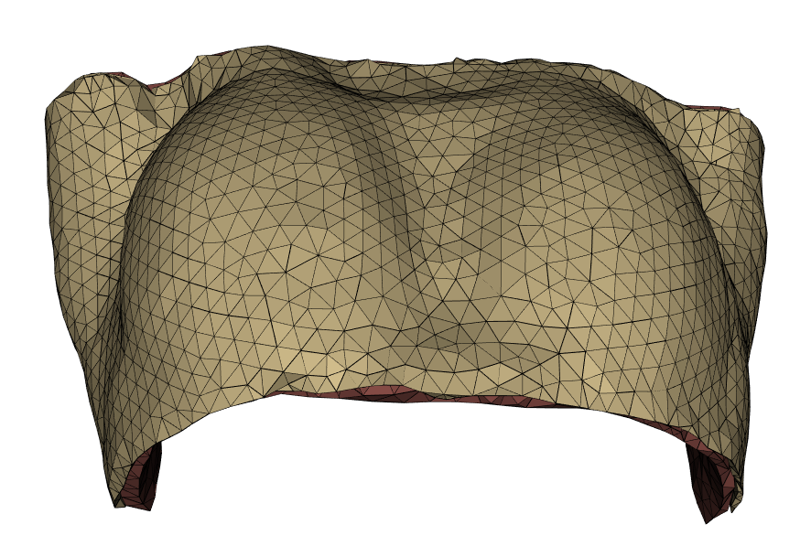
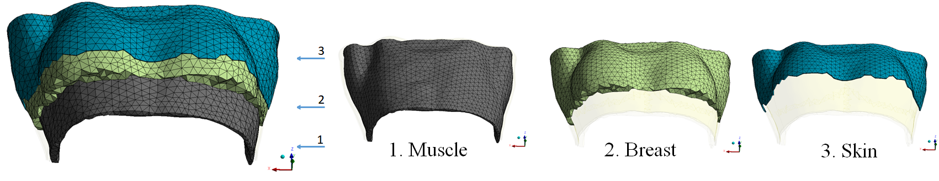
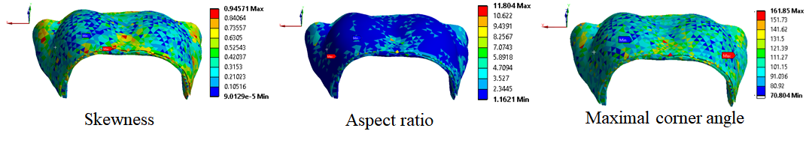
Elastic
parameters
Stress-free geometry estimation
Stress-free
configuration
Apply gravity towards posterior
Measured supine configuration
Estimated supine
configuration
G
Compute node to surface distance for the actives nodes (only surface nodes)

